Slide 1
How to add SharePoint to OneNote

Slide 2
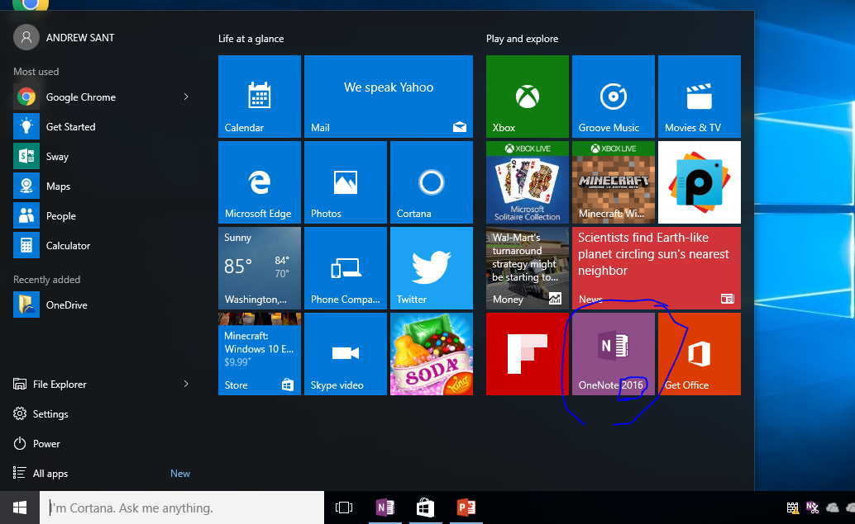
First open OneNote 2016
1.) First open the start menu.
2.) Open OneNote 2016. Make sure it is 2016 or you won’t be able to get in.
If it is not 2016 then search in the search box for “OneNote 2016”.

Slide 3
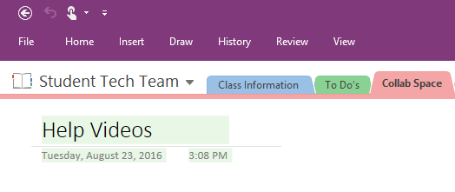
…Then click on file
In the top left corner click “File”.

Slide 4
Then click “New” on the purple column.

Slide 5
You then want to click on “add a place”

Slide 6
You are now able to click on “Office 365 SharePoint” to add it.

Slide 7
When you click on “Office 365 SharePoint” this window will pop up and prompt you for your school email and password after you have press “next”.

